Slide 1


DEPARTMENT OF COMPUTER ENGINEERING
-News Summarizer and Analyzer (Group no : 09 )
STUDENT NAME: ANUSHREE SALUNKE ROLL NO: 19 DIVISION:C
Student name: Eisha Saini Roll no: 15 Division:C
Student name: Pooja Tumma Roll no: 58 Division:C
Student name: Sanskruti Shinde Roll no: 42 Division:C
Under the Guidance of: Prof. Suchita DANGE

Slide 2

News Summarizer and Analyzer

Slide 3










Our Team
Eisha Saini
Roll No : 15
Anushree Salunke
Roll No : 19
Pooja Tumma
Roll No : 58
Sanskruti Shinde
Roll No : 42
News Summarizer and Analyzer

Slide 4

Current E-Newspaper websites:

Slide 5
Problem statement
In the current world situation when there is a rapid increase in the technology, the data on the World Wide Web is increasing on a tremendous rate. However due to the hectic schedule of the people and an intense amount of news available on various different websites it becomes difficult for people to be daily updated with the knowledge of the surroundings. Also as web is getting developed on a daily basis the news which might get surfaced on the web may not provide an overview of the news . We are not able to analyze what news should be read.
OBJECTIVE
To extract data from a News Website.
To categorize the news as per the domains.
To provide summarize content of the news
To provide the analyzed news in the form of graphs, charts along with categories.
News Summarizer and Analyzer

Slide 6
LIterature sURVEY
Paper 1 | Application | Dataset used | Algorithm | Future Scope | Result | Summary
Automatic News Article Summarization | Used for news summarization | News Article | Intelligence mining, RDF Triplets ,NER. | The future work extended would be to include different media types like image, video audio etc., to try different and more advanced density based clustering techniques[1] | The dataset used for summarization is ad- hoc and is generated on-the-fly. Using pre-processing steps like Sentence tokenization, NER, Stemming and lemmatization and Triplet formation [1] | This work presents a system to automatically collect, collate and summarize online newspaper articles based on a user submitted query. [1]
News Summarizer and Analyzer

Slide 7
LIterature sURVEY
Paper 2 | Application | Dataset used | Algorithm | Future Scope | Result | Summary
Automatic Text Summarization of News Articles | Used for news summarization | News Article | Lexical Chains, Anaphora Resolution C. Silber and McCoy Approach | The future work includes adding adjectives also to the lexical chains along with nouns and then observe the effect on the summary generated. [2] | They were able to auto-summarize news articles and compare summaries generated by them to analyze what scoring parameters would lead to better results. [2] | In the process, they tweaked methods had researched on to leverage the fact that were dealing with news articles only. They found that journalists follow a fixed pattern to write a news article. [2]
News Summarizer and Analyzer

Slide 8
LIterature sURVEY
Paper 3 | Application | Dataset used | Algorithm | Future Scope | Result | Summary
Daily Text Analytics of News and Social Media with Power BI | Used for news analyzation | News Article | SVM,KNN | The application developed is still crude and failed a few scenarios but is enough to test the usability of the concept. Many advancements can be further done in this project to make the outcomes refined. [3] | The objective of this capstone work was to implement a fully automatic and repeatable text analytics application using Power BI platform. [3] | Most text analytics works have been performed using R languages. Very few works have integrated text analytics application with power BI, as it is a more recent tool in market [3]
News Summarizer and Analyzer

Slide 9
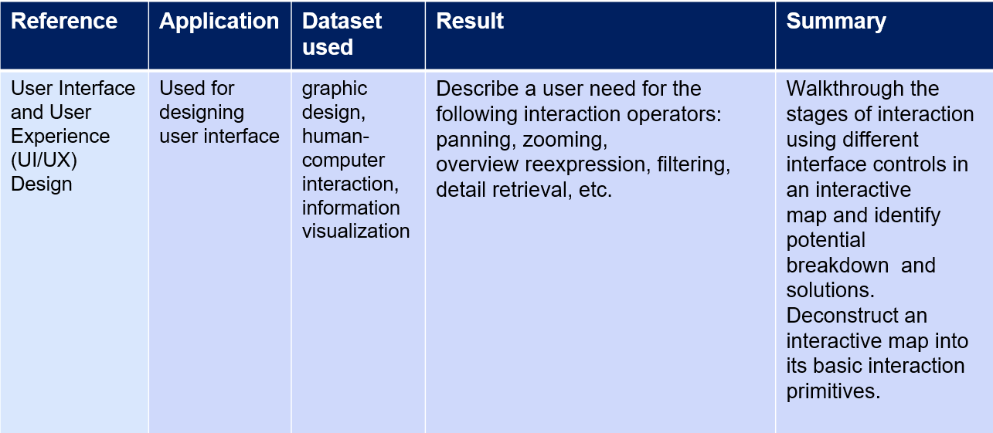
LIterature sURVEY
[4]
[4]
News Summarizer and Analyzer

Slide 10
Scope
1.To extract data through news Website
2.Segregating that news as per the Domain
3. Extracting the domain data count for summarization and analyzation
4. To store that count of the domain data in the database
5. Summarizing the news and displaying them
6. After summarization is done then Extracting the domain data count from database for analyzing.
7.Then as per category displaying that data in graphical representations
News Summarizer and Analyzer

Slide 11
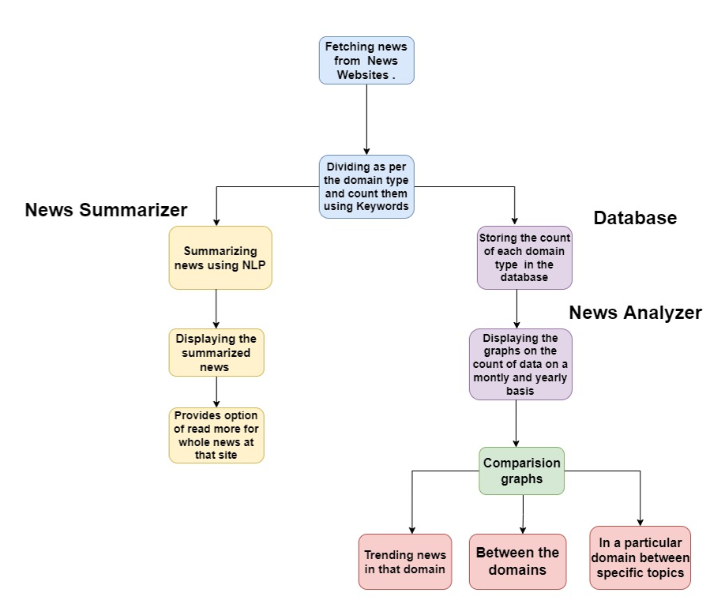
Flow Chart:

Slide 12
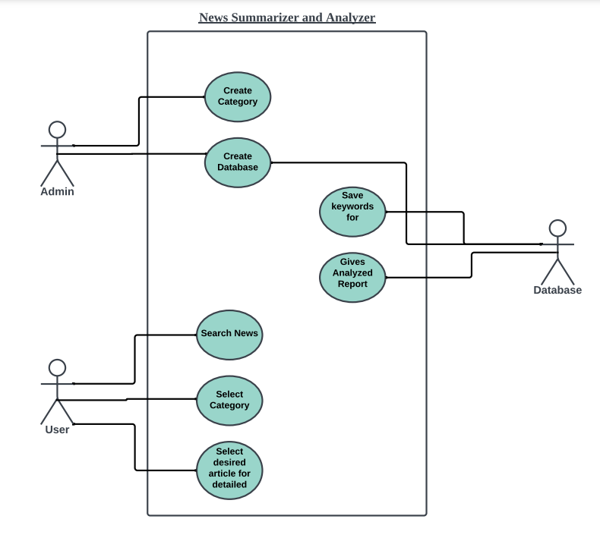
UML Diagram: Use Case :

Slide 13
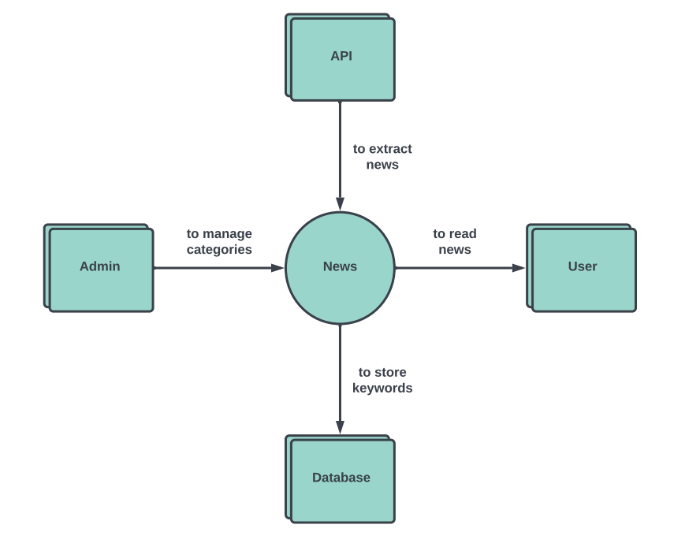
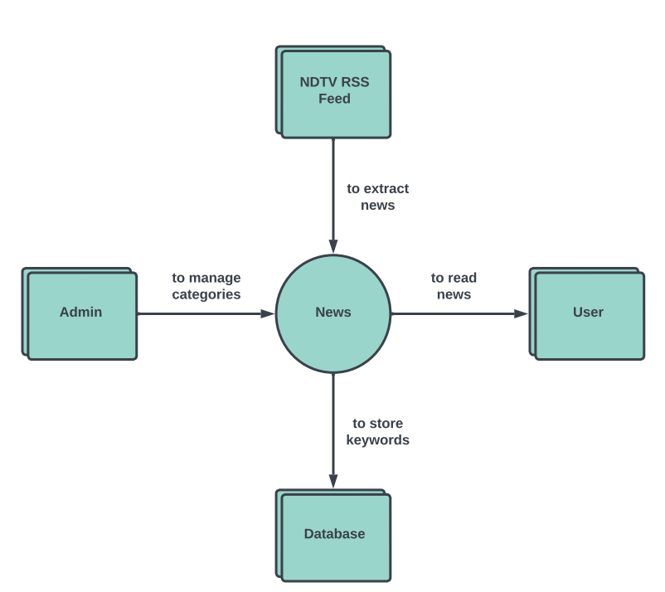
UML Diagram: DATA FLOW DIAGRAMS:
Level 0

Slide 14
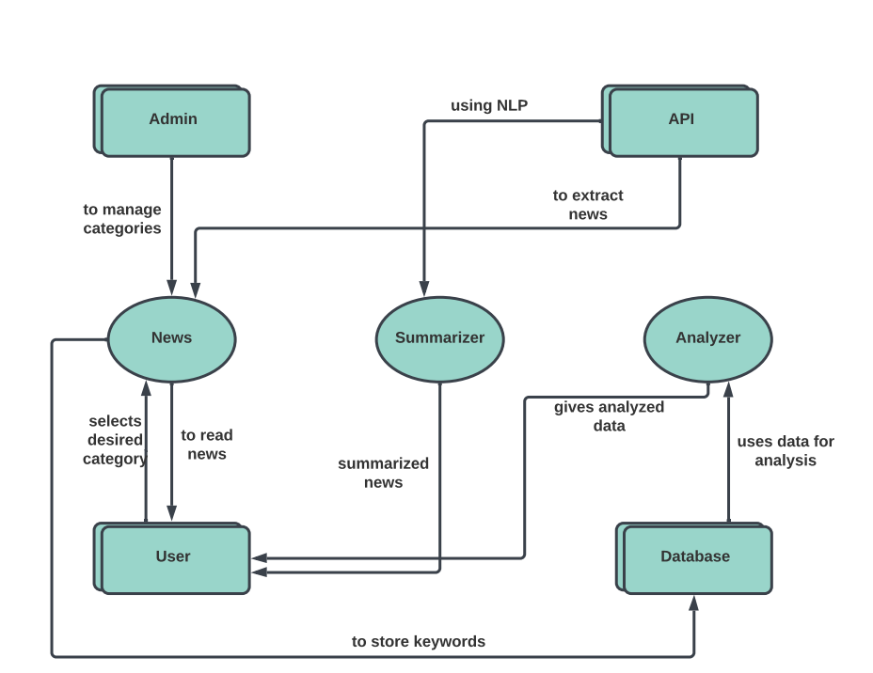
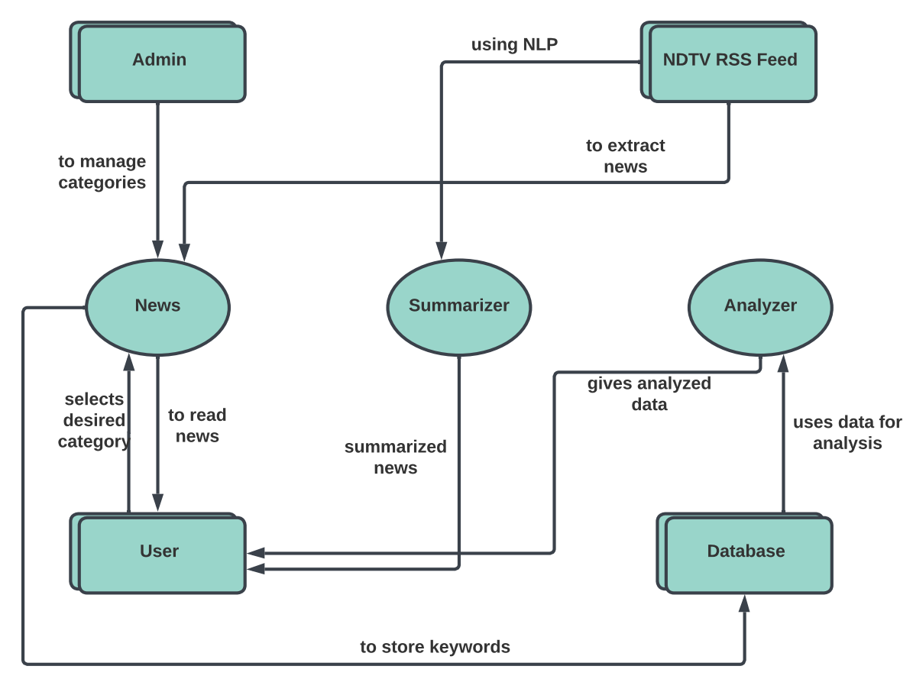
UML Diagram: DATA FLOW DIAGRAMS:
Level 1

Slide 15
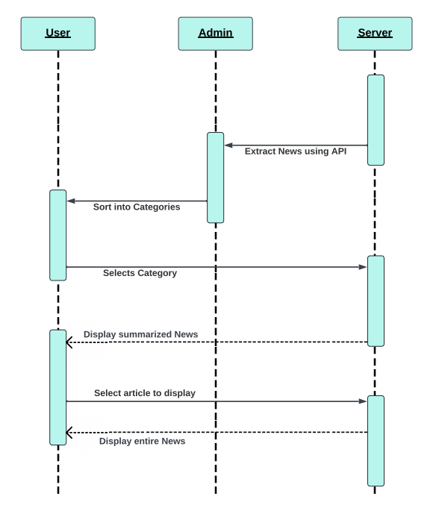
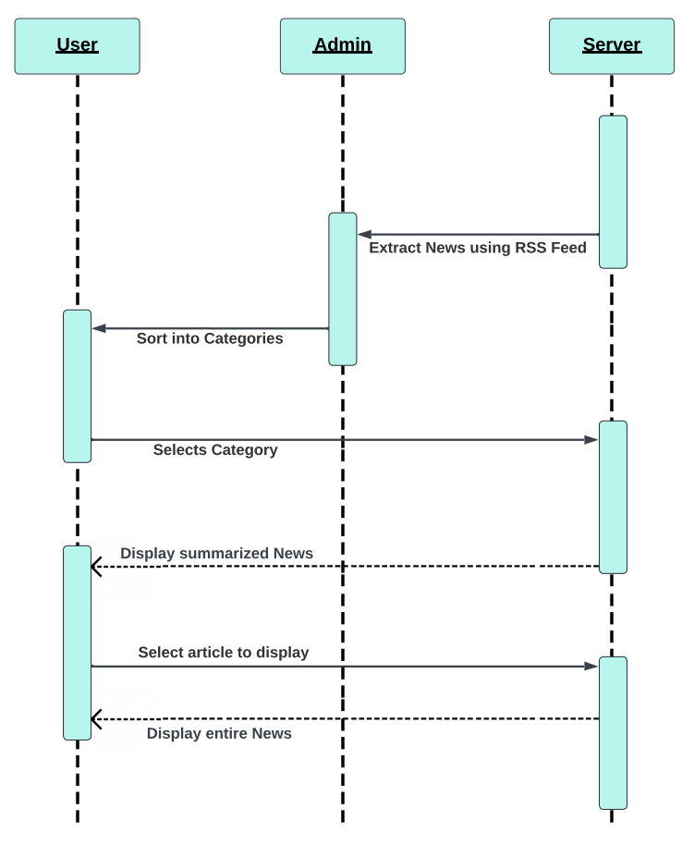
sequence DIAGRAM:

Slide 16
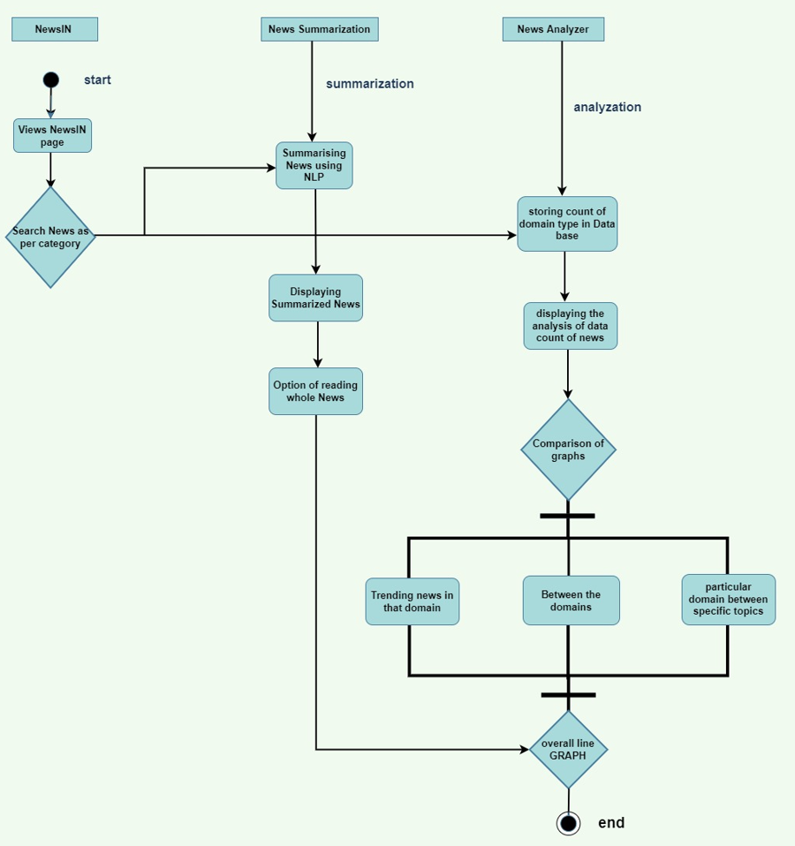
Activity DIAGRAM:

Slide 17

Implementation Technology
Html 5/CSS 3/ - frontend
Python 3.10 - backend
NLP
Plotly
Application connected via: News Website
Database: MySQL
News Summarizer and Analyzer

Slide 18
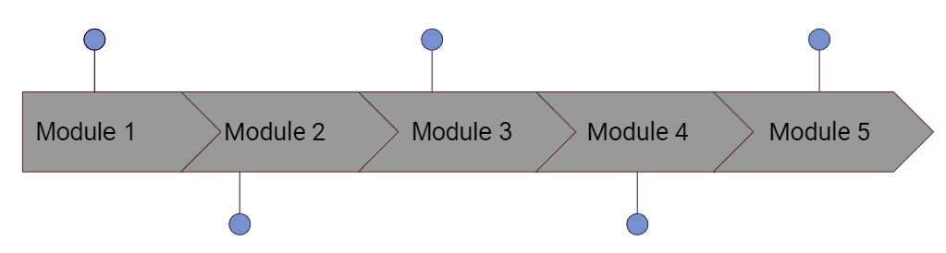
Modules :
Data Analytics through Graphs and charts
Fetching News
NEWS Summarization
Domain wise Classification
Analysis of NEWS Domain

Slide 19
Algorithm :
Step 1: Import all the Modules.
Step 2: Initialize a variable with 'Analyzer.xlsx'.
Step 3: Initialize function search topic.
Step 4: Open site.
Step 5: Read
Step 6: Initialize news_list=sp_page.findall('item') #finding news
Step 7: return news_list
Step 8: Repeat from steps 3 for various functions of various categories.
Step 9: Initialize function news_poster.
Step 10: Open poster link
Step 11: Read data
Step 12: Open Image

Slide 20
Algorithm :
Step13: Close function
Step 14: Initialize run() function
Step 15: Select category=[' --select-- ', 'Trending News', 'Favourite Topics', 'Search Topic']
If category[0] warning("Please select type !")
elif category[1] show trending news
elif category[2] select favorite topic
show favourite topic
Elif category[3] enter your topic
show entered topic
Step 16: End

Slide 21
Methodology :
1. Extracting news from NDTV News website.
2. Fetching news using RSS Feed.
3. Segregating the news based on different domains i.e., sports, technology, etc.
4. Summarizing the news using NLP.
5. After summarization we perform analysis on the news.
6. For performing analysis we store the news count of all the domains.
7. The news count of domains is stored in the database with the help of keywords.
8. Once the count got stored in the database, we converted it into csv file for performing analysis.
9. Analysis part was implemented by using Plotly.
10. By using plotly we generated pie charts for all the domains and also a line graph that will represent the weekly analysis of news.
News Summarizer and Analyzer

Slide 22
Pseudo Code :
def world_news():
site = 'https://feeds.feedburner.com/ndtvnews-world-news'
op = urlopen(site) # Open that site
rd = op.read() # read data from site
op.close() # close the object
sp_page = soup(rd, 'xml') # scrapping data from site
news_list = sp_page.find_all('item') # finding news
df=pd.read_excel(excel_file,
usecols='U:W',
header=0)
pie_chart=px.pie(df,
title='World',
values='world_count',
names='world_date')
st.plotly_chart(pie_chart)
df=pd.read_excel(excel_file,
usecols='BH:BM',
skiprows=33,
nrows=1,
header=0)
pie_chart=px.pie(df,
title='World',
values=['Russia','USA','UK','Asia'],
names=['Russia','USA','UK','Asia'])
st.plotly_chart(pie_chart)
return news_list

Slide 23
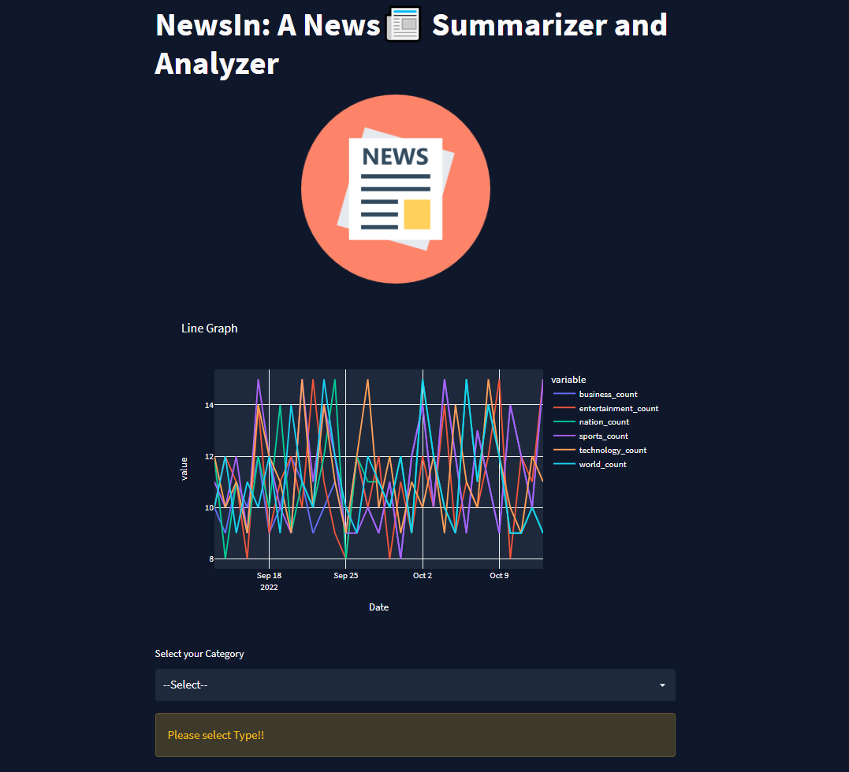
INTERFACES:

Slide 24
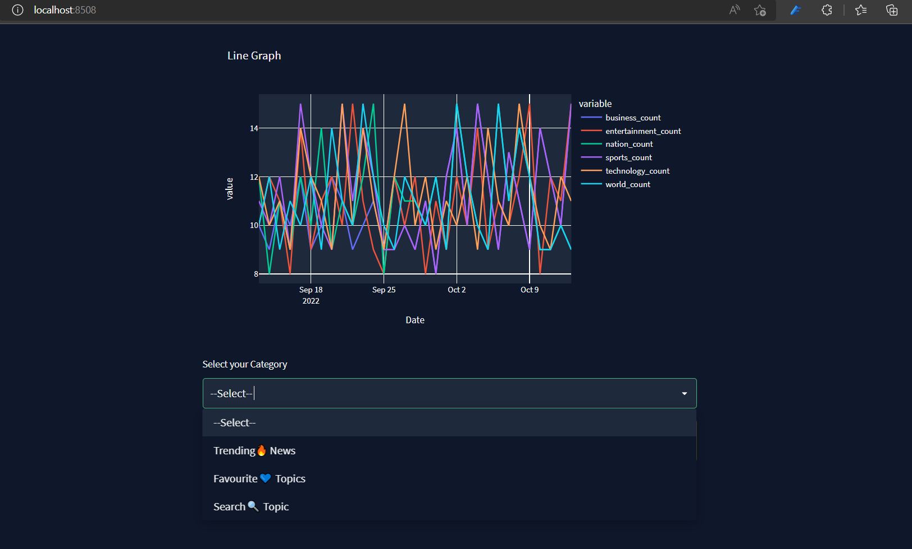
INTERFACES:

Slide 25
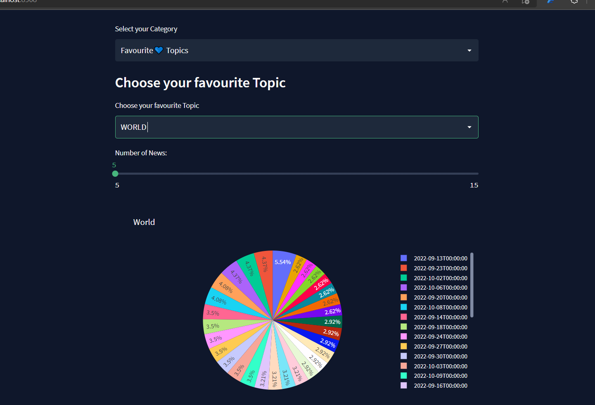
INTERFACES:

Slide 26
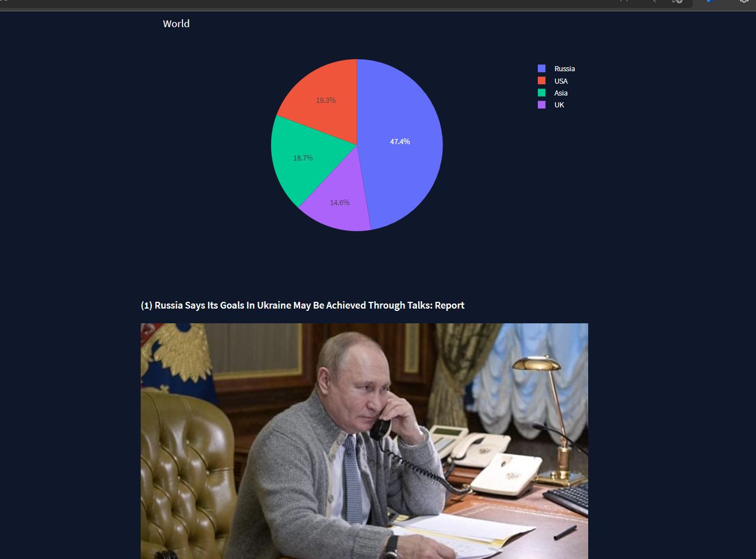
INTERFACES:

Slide 27
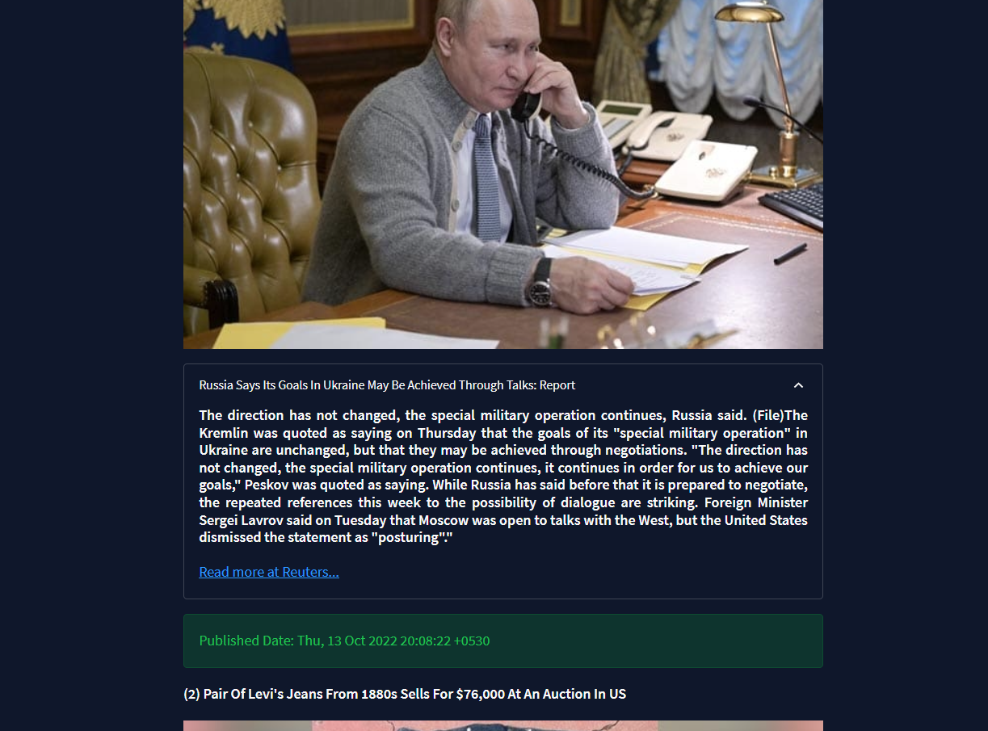
INTERFACES:

Slide 28
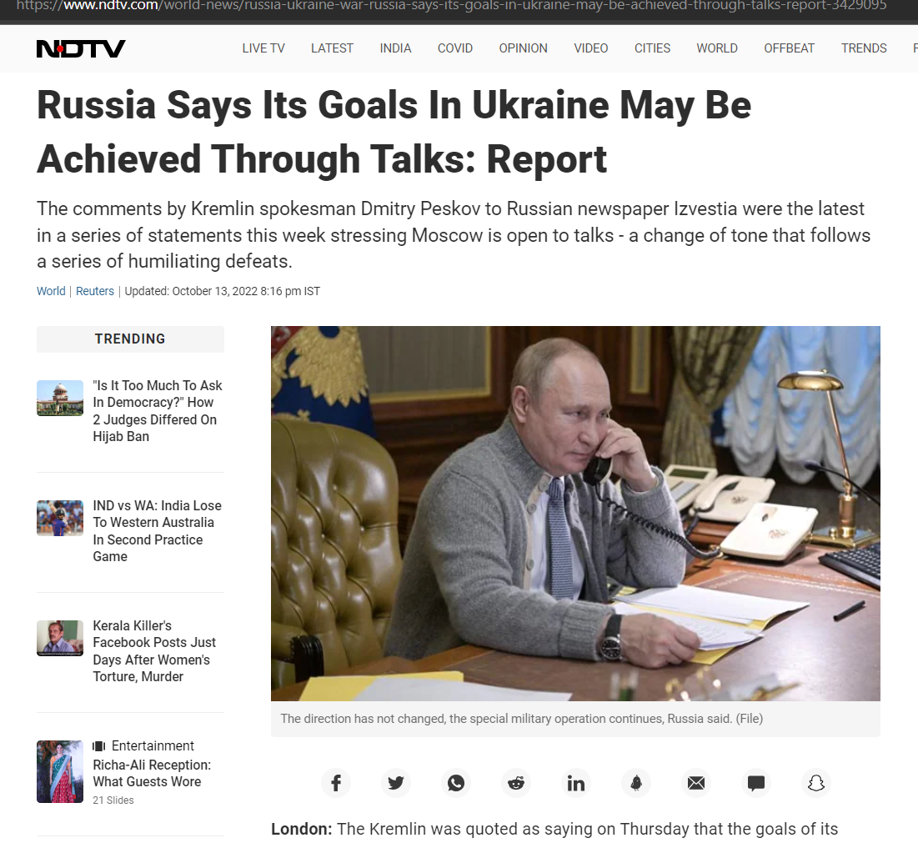
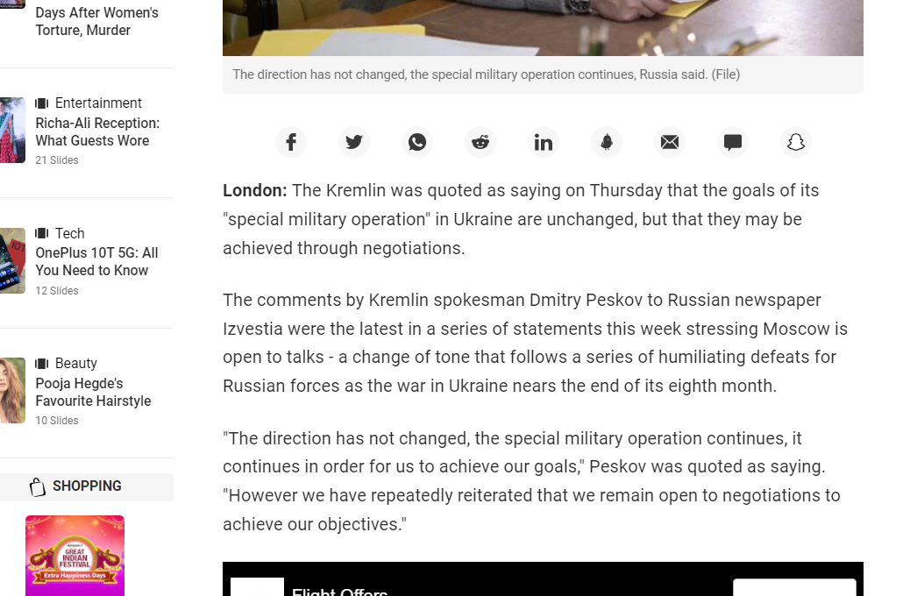
INTERFACES:

Slide 29
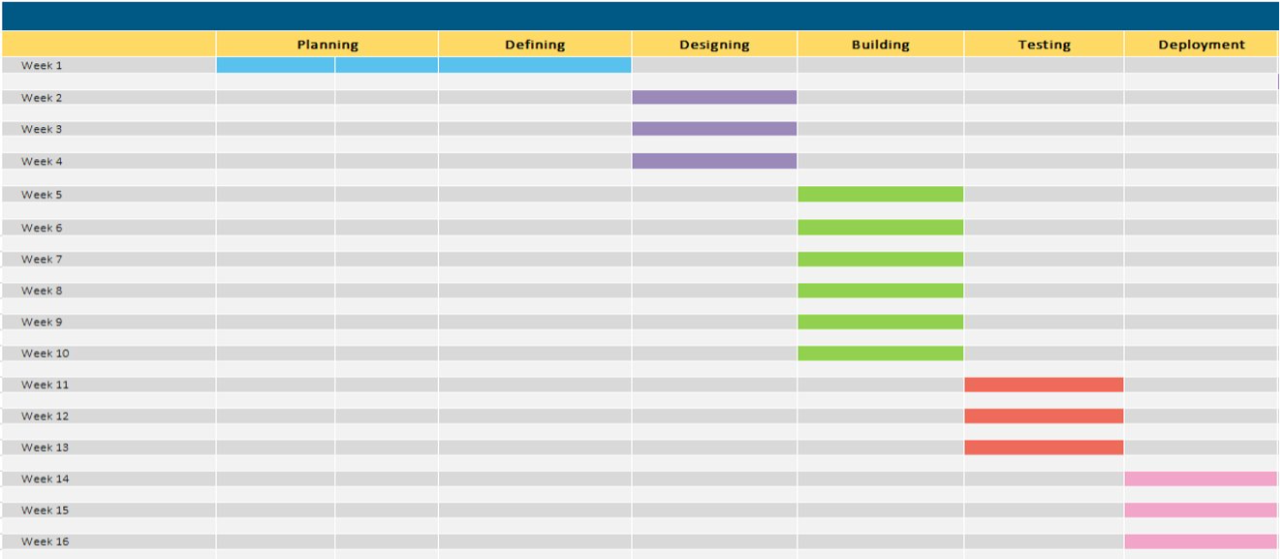
PROJECT PLANNING(GANTT CHART)
News Summarizer and Analyzer Gantt Chart
Project based on machine learning

Slide 30
References
REFERENCES 1 : HTTPS://WWW.RESEARCHGATE.NET/PUBLICATION/325775102_AUTOMATIC_
NEWS_ARTICLE_SUMMARIZATION
REFERENCES 2 : HTTPS://IEEEXPLORE.IEEE.ORG/DOCUMENT/8336568
REFERENCES 3 : HTTPS://UNCW.EDU/CSB/MSCSIS/COMPLETE/PDF/NAHAR_FALL2019.PDF
REFERENCE 4 : HTTPS://WWW.RESEARCHGATE.NET/PUBLICATION/317660257_USER_INTERFACE
_AND_USER_EXPERIENCE_UIUX_DESIGNNEWS SUMMARIZATION AND ANALYZER.PPTX
News Summarizer and Analyzer

Slide 31
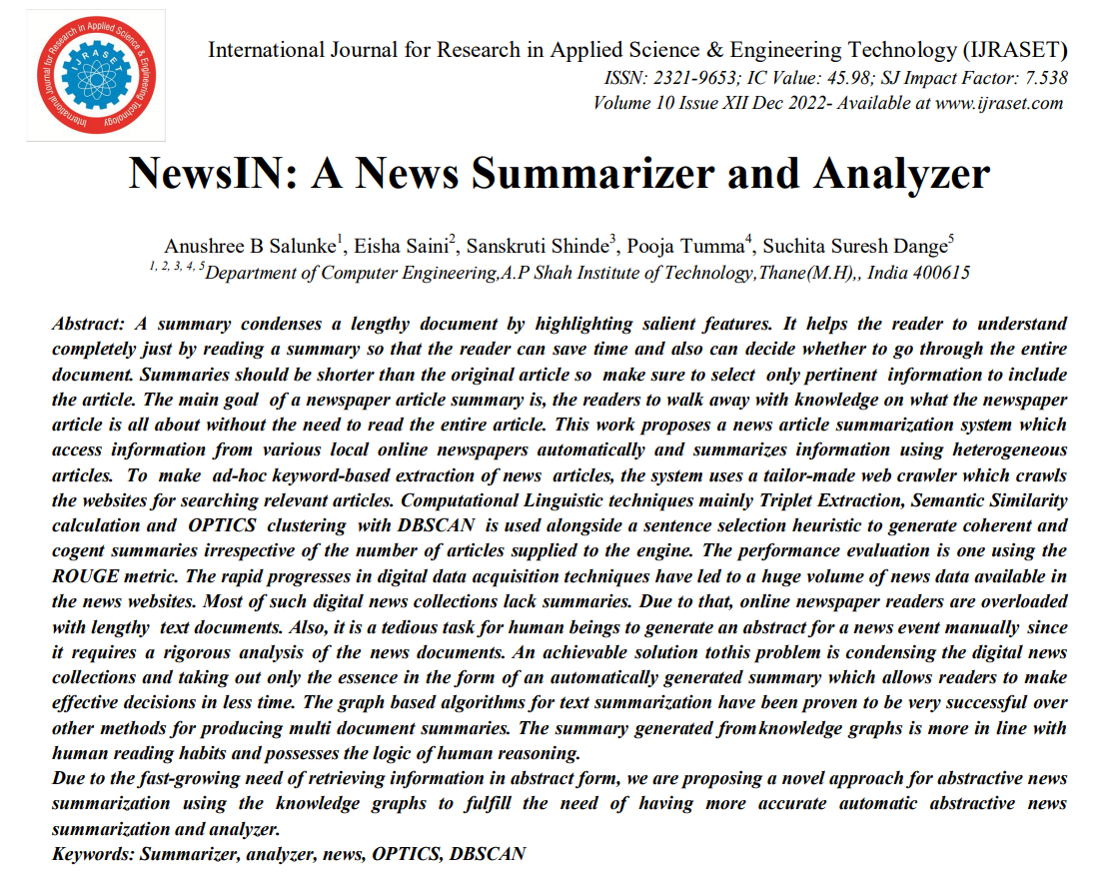

ReSEARCH PAPER
PAPER Link : https://www.ijraset.com/best-journal/newsin-a-news-summarizer-and-analyzer
News Summarizer and Analyzer

Slide 32


